Slide 1
Medical Expert Systems
Eddie Lai

Slide 2
History
1950s – scientists tried to use computers for “probabilistic reasoning and statistical pattern recognition”
1970s – realized that physicians do not make decisions based on probability or patterns
Several expert systems a.k.a knowledge based systems were released shortly after
MYCIN
ONCOCIN

Slide 3
MYCIN
Expert system to identify bacteria that was causing infections and then prescribe antibiotics
Developed in early 1970s
Written in LISP
Only used as research, never in practice
Found that MYCIN gave acceptable conclusions more often than disease experts
Beginning of expert systems; many other expert systems were released after this

Slide 4
What is ONCOCIN?
Medical expert system written in LISP
Developed in Stanford’s School of Medicine in 1979
Intended for use by oncologists
Used at Stanford’s Oncology Clinic
Used for managing patients already diagnosed with cancer and being treated with chemotherapy
Alter/delay treatment based on condition after certain treatment
Thousands of possibilities given the side effects of chemotherapy

Slide 5
ONCOCIN
Composed of two systems
Reasoner – knowledge base and logic
Interviewer – interface between ONCOCIN and user (oncologist)
Each runs on parallel processors to not slow each other
User enters information about patient (rather than what he used to do)
Reasoner returns conclusions for current visit and recommendations for next visit
User can choose what to pass on to patient

Slide 6
Knowledge Base Representation
Contexts
Organizing the knowledge base:“disease”, “protocol”, “chemotherapy”
Protocol – set of treatments to treat a certain tumor
Parameters
Patient attributes: blood cell count, test results, etc.
Used to determine next step
Rules
Data driven (forward chaining) or goal-driven (backward chaining)
Recommendations on dosages
Control blocks
Steps of performing treatment, dosages.
Calculating dosage

Slide 7
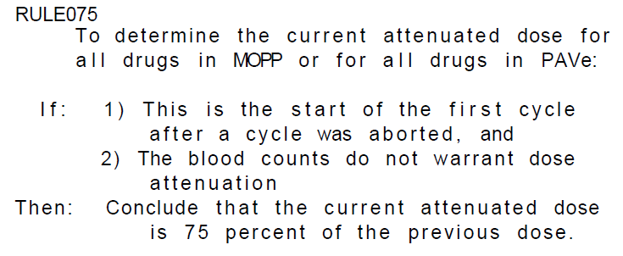
Sample rules

Slide 8
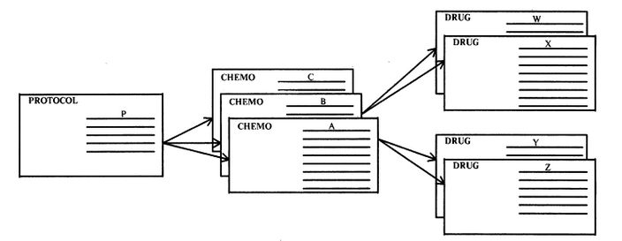
Heirarchy

Slide 9
Inputting data
Lots of information about cancer and treatments released constantly
Too much to frequently release new systems
Solution: must allow oncologists to input data
OPAL – graphical program used to add/modify a chemotherapy protocol
Add new flow chart
Create tree to follow a treatment

Slide 10
References
http://www.ncbi.nlm.nih.gov/pmc/articles/PMC1307157/?page=1
Medical Expert Systems—Knowledge Tools for Physicians by Edward H. Shortliffe, MD, PhD
http://citeseerx.ist.psu.edu/viewdoc/summary?doi=10.1.1.80.5446
ONCOCIN: AN EXPERT SYSTEM FOR ONCOLOGY PROTOCOL MANAGEMENT Edward H. Shortliffe, A. Carlisle Scott, Miriam B. Bischoff, A. Bruce Campbell, William Van Melle,
http://en.wikipedia.org/wiki/Mycin

Slide 11
Questions?

